Slide 3

About me
Developing software for +20 years
Now focused on developing people
tech & non-tech
Reach me via: https://www.linkedin.com/in/stevenhillaert/

Slide 4

Selling your ideas
Steven Hillaert

Slide 5
Assumptions
It’s actually a good idea
Realistic
WITHIN budget

Slide 6

Your idea
You had a lightbulb moment
It’s a great idea, the best idea
It will solve all problems
You’re passionate
You’re using facts and figures

Slide 7

First contact
That will never work
That’s not how we do things
We’ll think it over
Send me an email
…
They’re not sharing your enthusiasm: there’s resistance

Slide 8


Why is that?
How we see our idea VS how others see our idea

Slide 9

What do you do?
More facts and figures?
Keep repeating it every retrospective?
Keep showing your frustration?

Slide 10

Don’t fight resistance
Trying the same thing rarely gives different results
More facts and figures won’t help
People get used to your rant
Stop pushing your idea
When you’re new on a team, don’t be the asshole who wants to change everything immediately!

Slide 11

Start pulling people
Involve people in your idea
Give them a say
Start a dialogue
Make them feel it’s as much their idea than yours
It’s all about empathy!

Slide 12

Who do you pull?
Don’t pull everyone
Pull the most resisting person
Look for an ally or a sponsor
Allies might not be part of your direct environment
Notes:
Allies: case of difficult PM and using architect

Slide 13

Get to know them
What are they afraid of?
What are their objectives and KPI’s?
What do they care about?
Show interest in what they do
Show you care about their concerns
Build trust
People are rarely afraid of the change itself.
They are afraid of the impact on their status.
Notes:
Start with the quote.
How can your idea align with their objectives.
Case: working with the security team to build trust to improve developer experience.

Slide 14

Start a dialogue
Can I pick your brain for something?
What parts do you like?
How could I make this work for you?
What score (0 – 10) would you give this? Anything above 0 is good!
Notes:
When people are resisting you have to start a dialogue.
Don’t always come with a full plan, this doesn’t allow for a dialogue.

Slide 15

Think HOW you communicate
Is it a technical or financial person?
Does he prefer text?
Does she prefer visuals, schemas…?
Details or bullet points?
Email, Teams, face to face…
Adapt to their mental framework.

Slide 16

Authority
Selling up the hierarchy
Added value
Reducing cost
Align with objectives
Align with the vision
Build trust
Selling to your peers
Ego
Fear (impact on status)
Ask for input or help
Involvement
Build trust
Selling down the hierarchy
Involvement
Explain WHY
How will it help them?
Build trust

Slide 17

Conclusion
Pull them towards your idea
Empathy and respect their perspective
Build trust
Start a dialogue
Compromises

Slide 18
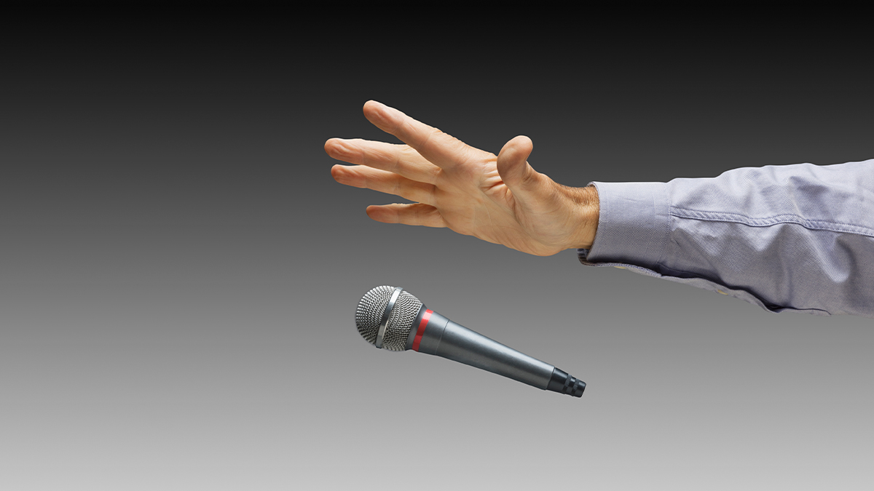
Thank you
Questions?

